Slide 1

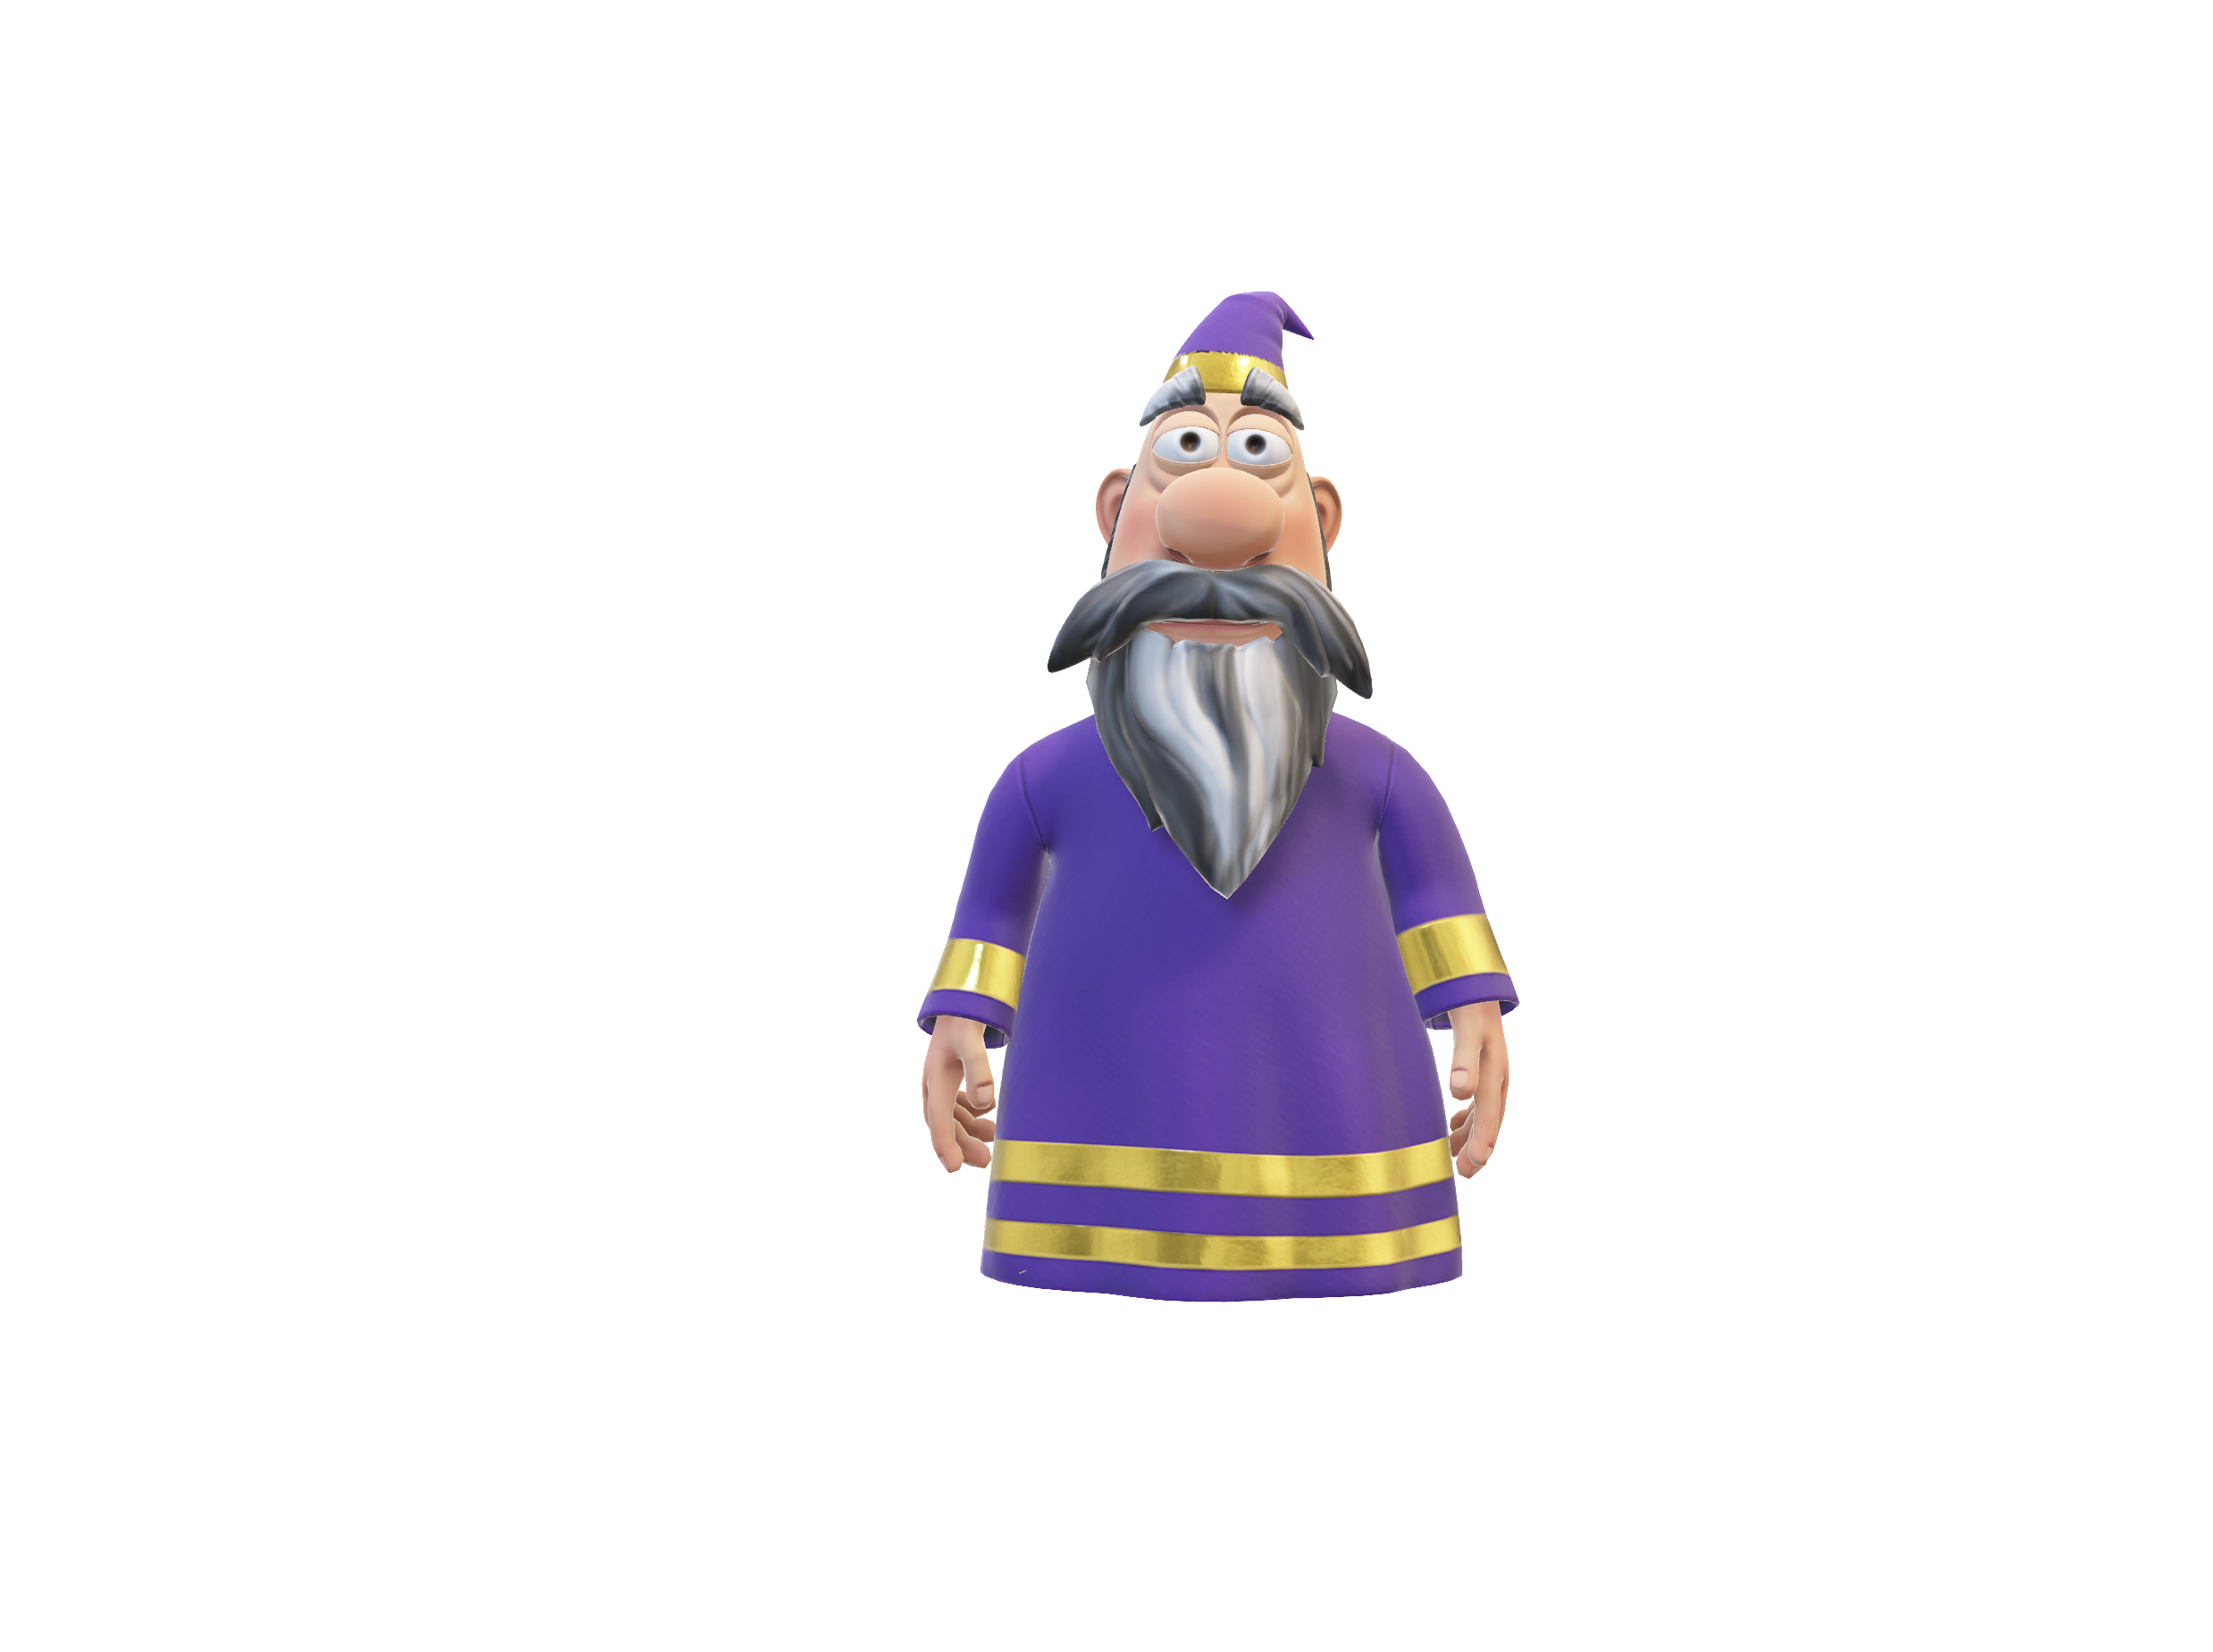

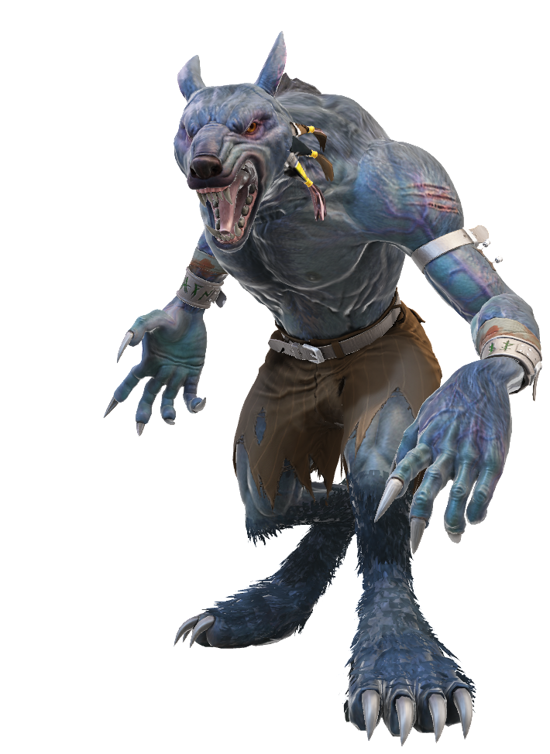
The quantum werewolf
By Ludovic Marcotte, Louis-Félix Vigneux, Wilhem Harvey and Rémy Lyscar
For the iQuCodeFest

Slide 2

The core mechanic
Player alife
Qubit representing a player
Two phases:
The night phase
The day phase
Qubit represent the life of a player:
Player lives if state measured is |0>
Player dies if state measured is |1>
Player dead

Slide 3
Explication of the day phase
The vote: instant check to see if the player dies.
|0>
Voted player
Rx(2π/3)
|0>
|0> or |1>, lives or die
|1>

Slide 4
Explication of the night phase
Qubits are measured in the morning
in the Z-basis.
Gates are applied during the night phase.
Rx(2π/3)
Rx(-π/3)
𝛼|0> + β|1>
Player 1 (role)
|0>
|1>
Player 2 (role)
|0>
|0>
𝛼|0> + β|1>
|0><0|
|0>
|1>
Player 3 (role)
𝛼|0> + β|1>
Player 4 (role)
|0>
|0>
𝛼|0> + β|1>
…
...

Slide 5

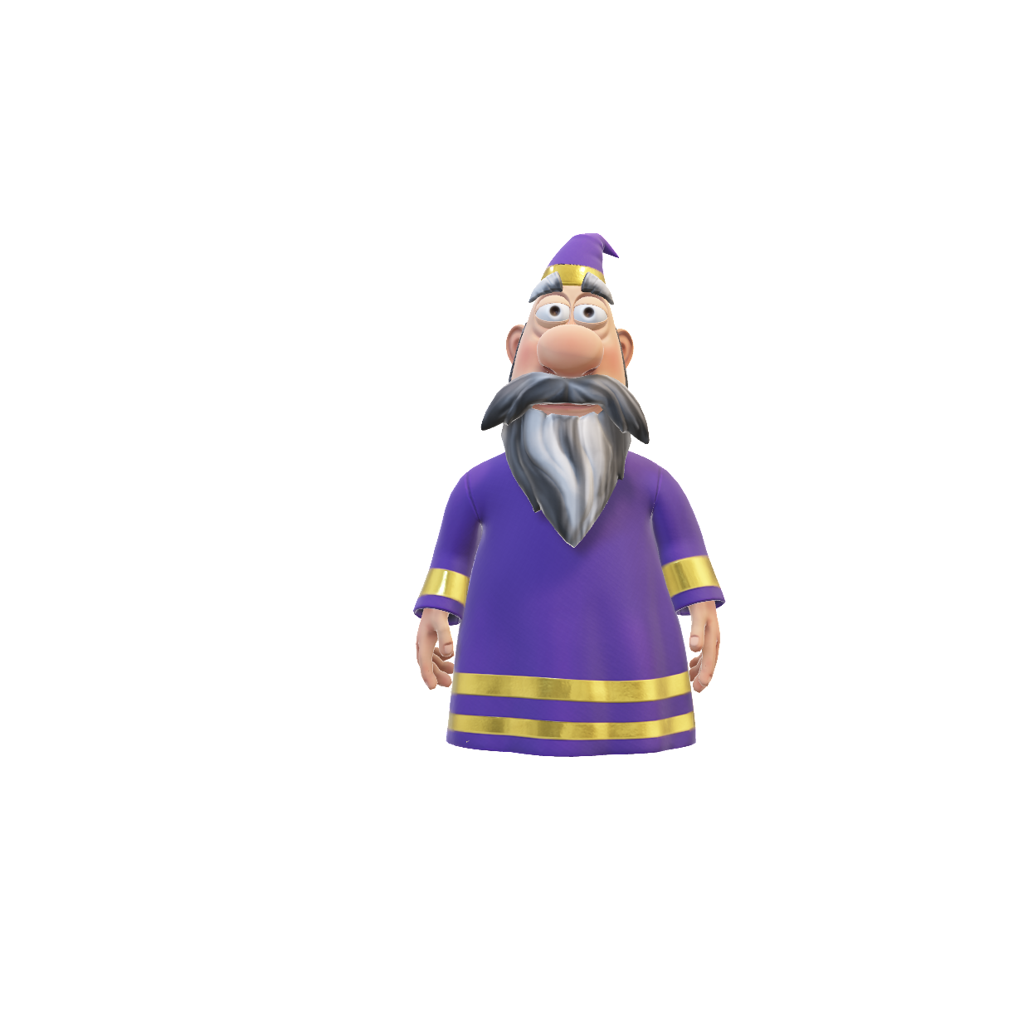
The roles
Order of the roles:
The cupid
The seek
The werewolves
The witch
The saviour
The thief
* Other roles:
The hunter
The captain
The villagers

Slide 6
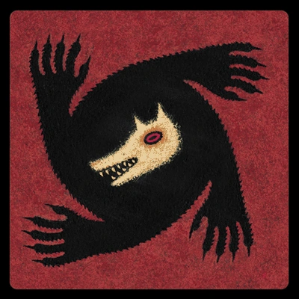

Explication of the quantum roles
Werewolfs
Little attack gate
The witch
Rx(π/3)
Attack gate
Rx(2π/3)
Or
Little save gate
Rx(-π/3)

Slide 7
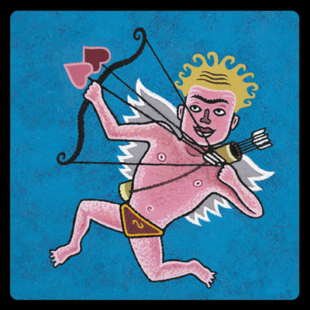

Explication of the quantum roles
The cupid
The saviour
Entangle two players
Reset to |0>
|0><0|

Slide 8
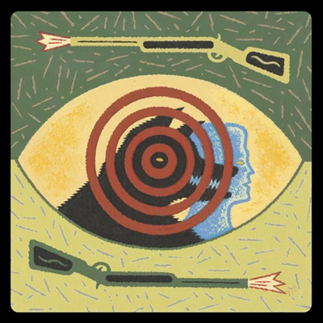
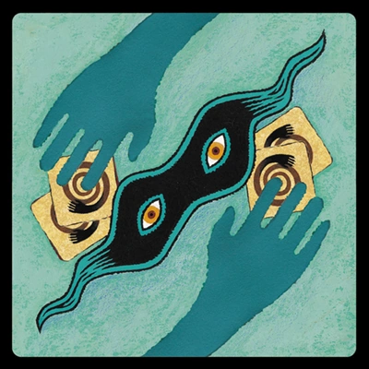
Explication of the quantum roles
The hunter
The thief
Big attack gate when
he dies
Swap gate
Rx(ϴ)
90% probability for the targeted player to die

Slide 9



Explication of the classical roles
The captain
The seek
The villager

Slide 10
Our implementation

